Slide 1
Roles & Responsibilities
As DC Quest

Slide 3
Form your Team
Take new enthusiastic members
Guide them
Give them freedom to explore
Spread your reach & network

Slide 4
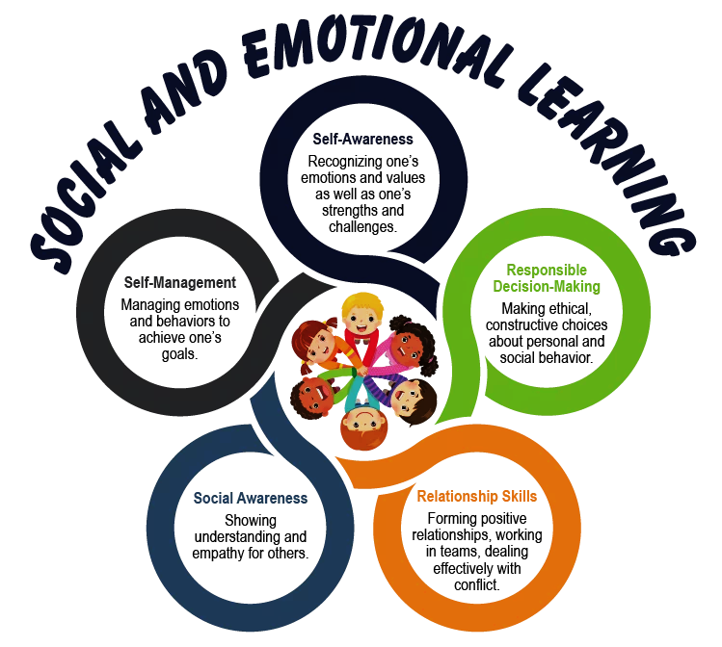
Awareness programs
PST, District function (Quest videos)
Region meets
Club meets
Online for whole district
School PTA meets
Any school project of clubs
Short, Crisp, to the point, connect with NEP

Slide 5
Past Data
Check with LQIF/ shared with you
Talk to Past DC/DG
Contact schools/Clubs
Sponsors
Need assessment

Slide 6
One club one school
Lions Quest as permanent activity/ Club Chairperson
International youth program (developing life skills)
School where the club is already doing service activities
The club & school coordination
Financial partnership with school (for Quest)
Encouragement to clubs
Online Awareness sessions for clubs and schools

Slide 7
Role of Lions Club
YOUTH
Awareness at club and school
Plan for Quest implementation
Plan for TTW if no trained teachers
Be part of school climate team
Support in parent meets and evaluation
Honour the teachers, students when implementation is complete
Support the school in other needs

Slide 8
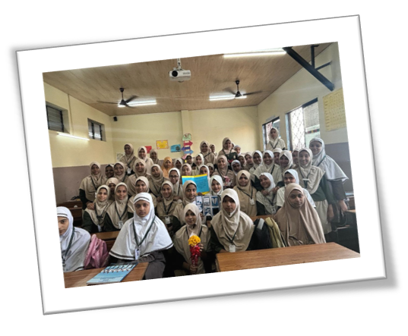
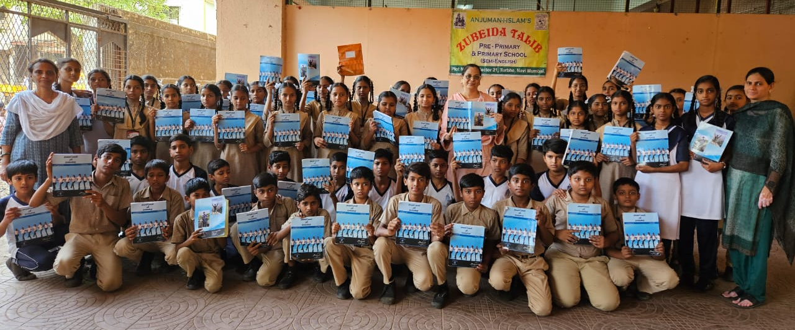
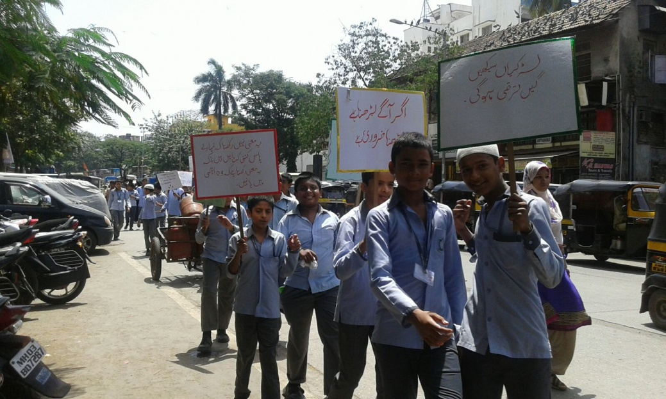
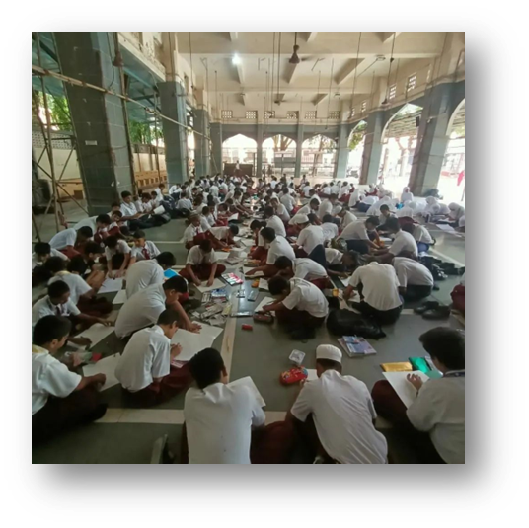
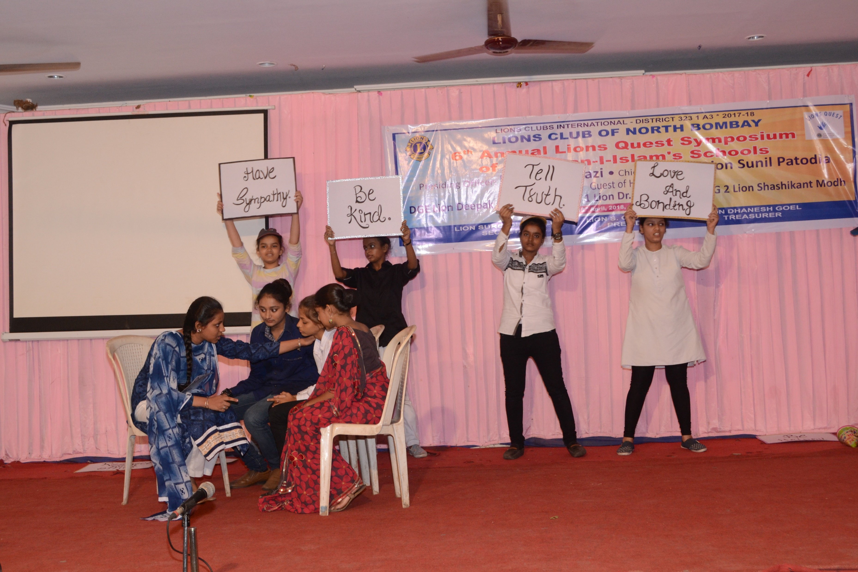
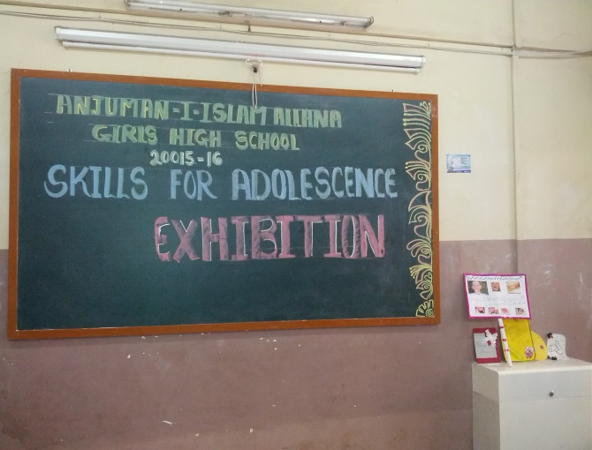
Lions Quest Week (26th August -1st September)

Slide 9
Lions Quest Week
Physical/ online awareness seminars with clubs, schools, distribute Quest awareness materials, brochures, Press release
Organise parent seminars in school, housing societies,
Talk shows on importance of SEL and how Lions Quest fills this gap in academics
Plan/inaugurate implementation, TTW, schools, Out of school
Honouring of teachers who have implemented the program,
Introduce club awards from District,
Organise rally for awareness on importance of SEL program,
Introduce/conduct EMEL programs,
Poster making competition on SEL/ Lions Quest,
Region and Zone wise activities on Lions Quest, involve RC and ZC
And many more.

Slide 10
Implementation
Clubs
Schools/Out of school
Students
Teachers
TTW
Implementation
Parents Partnership
Impact study

Slide 11
International Recognitions
Social and Emotional Learning (CASEL)Collaborative for Academic, Social, and Emotional Learning “Select SEL” Program
https://www.tlpnyc.com/blog/exploring-casel-select-programs
Substance Abuse Prevention National Registry of Evidence-Based Programs and Practices (NREPP)
Character Development “Scientifically supported programs” that address Character Education Partnership’s Eleven Principles of Effective Character Education (CEP)
Service-Learning “Highly Effective” ratings from National Youth Leadership Council, the National Service-Learning Clearinghouse, and the Service Works Retrospective Evaluation (NYLC)
Criteria for CASEL SELect Designation
To achieve the prestigious CASEL SELect designation, programs must meet the following criteria:
Evidence-Based Practices
Implementation Fidelity
Assessment and Continuous Improvement
Benefits of CASEL SELect programs:
Improved Academic Performance
Enhanced Social Skills
Emotional Well-being
Positive School Climate
Long-term Life Skills

Slide 12
Empowering Mind Enriching Life (EMEL)

Slide 13
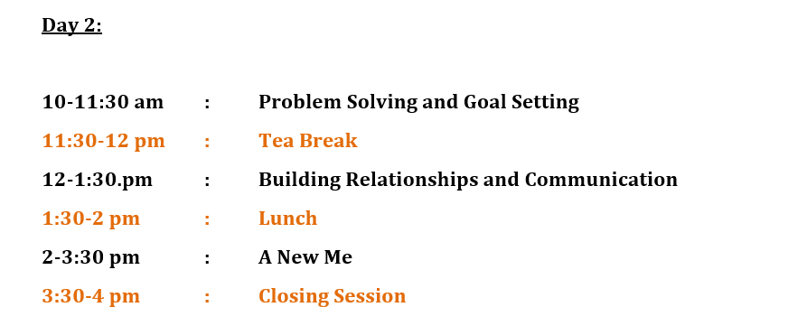

Slide 14
Follow ups
Team
RC/ZC
Clubs
Schools
Teachers
Prospective Sponsors
District Governor

Slide 15
Rewards
Schools
Teachers
Students
Clubs
Team
Sponsors

Slide 16
Lions Quest – Working as DC
School/students/
teachers/TTW/
Implement/finance/ Impact study
Team, PST, Cabinet, RC-ZC Meets, Clubs, Schools, Online/physical,
Contact clubs, promotion, Motivation
One club one School
Awareness
Implementation
History
Quest week
Rewards
The past records, lists, the need of different approach, refresher, implementation
Promotion materials, TTW, talks, competitions, EMEL, Parent Seminars
Clubs/schools/ teachers/ Donors/ keep records/ rewards

Slide 17
Some insights
Need assessment of your district
List of Quest Chairperson of clubs
Create a Region wise google sheet for clubs
Create ripples in Quest week
Refresher workshops
Establish Continuity
Sharing the expenses will ensure continuity.
Share the data as required with LQIF

Slide 18
Cost Prices include trainer fees, transportation and expenses, workshop materials and shipping.
Two-Day Workshop $3500 (8:00 a.m. - 3:30 p.m.)
Not included:
• Curriculum kits - purchased at $120 each
• Those not needing a curriculum (refresher course, support staff, etc) attend for $20 each
• Flipcharts and A/V equipment
• Food and beverages for participants and trainer during workshop
Setting Up a Sponsored Workshop:
Choose a convenient workshop date.
Request a Sponsored Workshop Agreement or download from www.lions-quest.org.
Submit completed Sponsored Workshop Agreement to Lions Quest.
Secure workshop facility, equipment and catering.
Send prospective participant list to Lions Quest (not to exceed 40).
Provide participants with workshop agenda and details.
From LCIF website

Slide 19
PRESENTATION BY Sunita malpani
2024-25

